Slide 1





Chitosan Global
April 2026
Chitosan IG for Tomato Pathogen Suppression
Chitosan IG Tomato Pathogen Suppression
$130
6 g/L
98%
Technical validation, efficacy rationale, and unit economics for Chitosan Global's Chitosan IG
in tomato disease management. Product specs: 98% DDA, 3 kDa MW, +71mV zeta potential.
per kg
dosage
DDA
Investment Objectives
Evidence Summary (2020-Present)
Evaluate technical validity and efficacy rationale for Chitosan IG in tomato disease management
Pathogen | Evidence | Strength
Fusarium solani | Strong in vitro/in vivo | ●●●●●
Botrytis cinerea | Postharvest/foliar | ●●●●○
Phytophthora infestans | Synergy with fungicides | ●●●●●
Xanthomonas spp. | Nano-formulations | ●●●○○
Analyze per-application cost modeling at $130/kg and 6 g/L dosage
Benchmark against conventional fungicides (copper hydroxide, mancozeb, azoxystrobin)
Assess addressable use-cases and commercial positioning
Key Performance Indicators
Mycelial Inhibition
Disease Index Reduction
Cost Analysis Summary
81.25%
45.1%
@ 3 g/L (Fusarium solani)
vs. control
Per Application
vs. Conventional
$156-468/ha
$20-62/ha
(200-600 L spray volume)
(Copper/Mancozeb)
Copyright 2026 Shield Nutraceuticals/Chitosan Global
Herbert Herman
herbert@chitosanglobal.com
Ready for Review

Slide 2




Chitosan IG Product Specification
April 25, 2026
Verified COA data and technical specifications
Chitosan IG (Industrial Grade)
98.67%
3 kDa
+71mV
Verified specifications from COA, MSDS, and product documentation | CAS: 70694-72-3
DDA
MW
Zeta
Verified Specifications (COA 2026)
Technical Specifications
Parameter | Specification | Result | Status
Degree of Deacetylation | ≥95% | 98.67% | Verified
Molecular Weight | <3000 Da | ~3 kDa | Verified
Zeta Potential | +60 to +75 mV | +71.04 mV | Verified
pH (1% solution) | 2.0 - 5.5 | 4.48 | Verified
Insoluble Matter | ≤1.0% | 0.01% | Verified
Purity | 98.0-99.5% | 99.13% | Verified
Property | Value | Unit
Solubility | Completely soluble | in DI water
Viscosity (1% @ 30°C) | 6.59 | cSt
Moisture Content | ≤10% | %
Ash Content | ≤1% | %
Heavy Metals (as Pb) | NIL | ppm
Mesh Size | Customizable | -
Source: Chitosan 70 IG COA (Jan 2026), Promecens Entosystems
Economic Modeling Basis
Product Details
Price Assumption
Dosage
Form
Source
$130/kg
6 g/L
Chitosan Oligosaccharide Hydrochloride
Mushroom/Insect
Scenario input
Application rate
Lenzites betulina
Cost per liter of spray: 0.006 kg/L × $130 = $0.78/L
Copyright 2026 Shield Nutraceuticals/Chitosan Global
Herbert Herman
herbert@chitosanglobal.com
All specifications verified
Fully water-soluble powder
Key Feature: Low molecular weight (<3kDa) enables systemic penetration and rapid cellular uptake for enhanced antimicrobial activity.

Slide 3




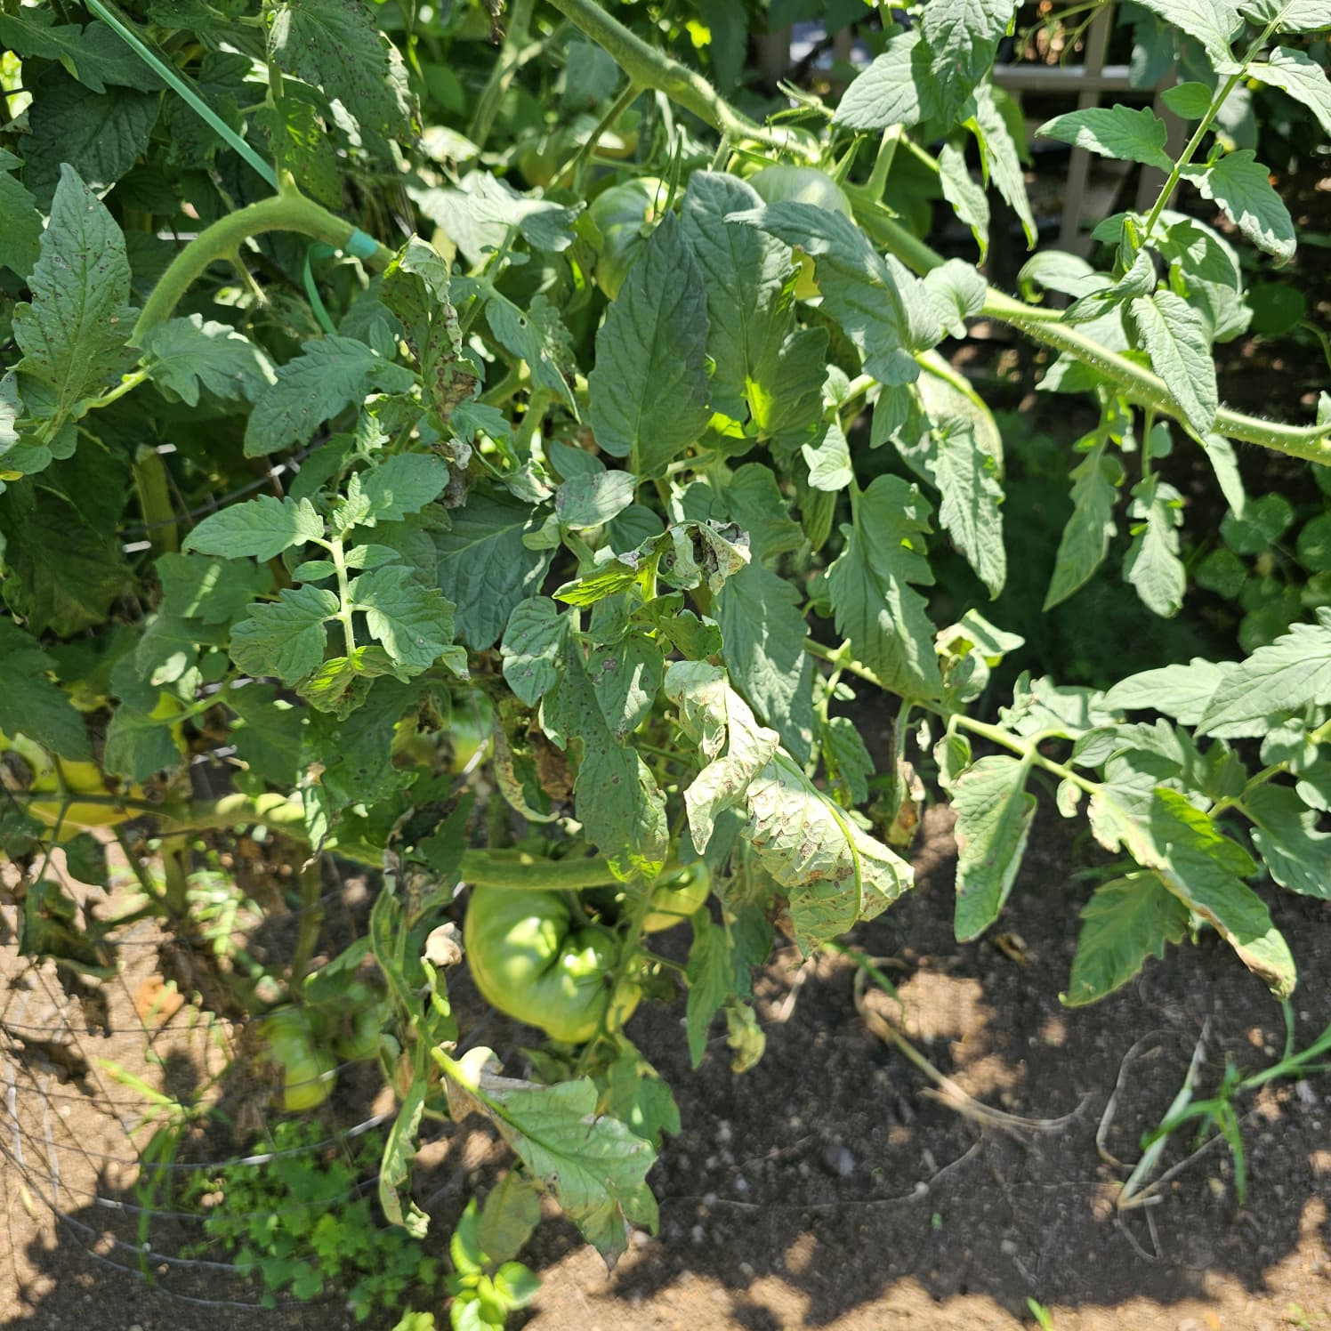
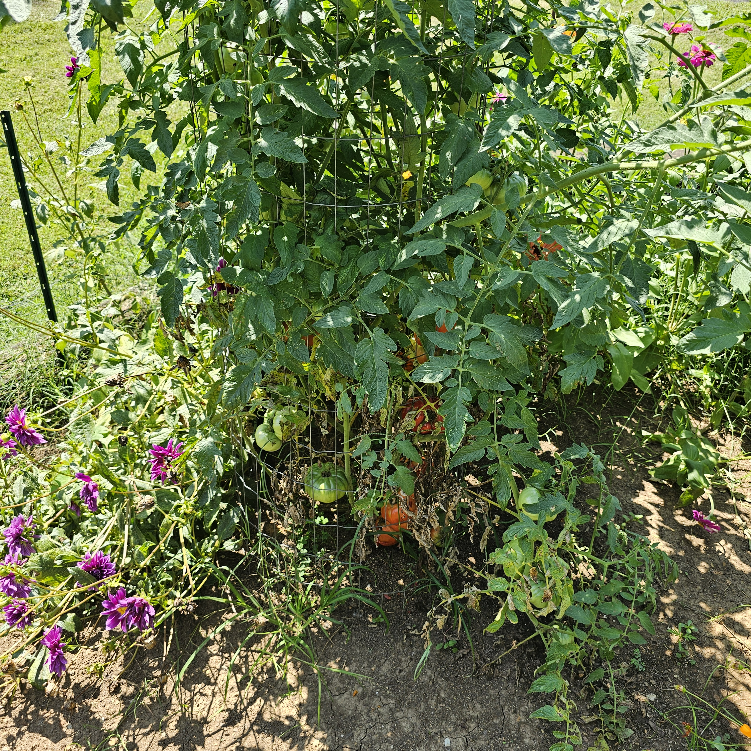
Mechanism of Action
April 2026
Technical Analysis
Why 3 kDa, 98% DDA, and +70 mV matter for pathogen suppression
Direct Antimicrobial + Induced Plant Immunity
98.67%
3 kDa
+71mV
Dual mechanism of action: Electrostatic binding and defense activation
DDA
MW
Zeta
Direct Antimicrobial Effects
Induced Plant Immunity
Parameter Effects
1
2
SA/JA Signaling
ROS Burst
Parameter | Effect | Impact
DDA 98% | More protonated amines | Stronger charge interaction
MW 3 kDa | Systemic penetration | Enhanced uptake
+71 mV | High zeta potential | Stable dispersion
pH 4.48 | Optimal protonation | Max activity
Electrostatic Binding
→
Membrane Disruption
Activated ↑45%
Enhanced ↑60%
Polycationic chitosan binds to negatively charged microbial surfaces
Permeabilization causes intracellular leakage
PR Proteins
Lignification
Upregulated ↑35%
Increased ↑25%
3
4
Biofilm Degradation
→
Metabolic Interference
Mechanism: Chitosan triggers systemic acquired resistance (SAR) through defense gene activation
Destabilizes bacterial/ fungal cell walls
Inhibits protein/mRNA synthesis
Activity depends on pH (protonation below pKa)
Key Finding: 3 kDa oligomers penetrate cell walls more effectively than high MW chitosan (PMC10095919)
Copyright 2026 Shield Nutraceuticals/Chitosan Global
Herbert Herman
herbert@chitosanglobal.com
Mechanism verified

Slide 4






Tomato Pathogen Relevance Map
April 2026
Pathogen Analysis
Evidence strength ratings by pathogen category
Pathogen Categories and Evidence Strength
6
3
Fungi, oomycetes, and bacteria with clinical relevance to tomato production
Pathogens
Categories
Fungi (Strong Evidence)
Oomycetes (Strong Evidence)
Bacteria (Emerging)
Fusarium solani
Phytophthora infestans
Xanthomonas spp.
Root rot/Wilt
Late blight
Bacterial spot
Botrytis cinerea
P. capsici
P. syringae
Gray mold
Phytophthora
Bacterial speck
Alternaria solani
Evidence: Strong in vitro inhibition and induced resistance; synergy with fungicides reported
Note: Most efficacy via nano-formulations or combinations
Early blight
Fusarium oxysporum
Wilt
Key: 5 dots = Strong evidence, 3-4 = Moderate, 1-2 = Weak
Copyright 2026 Shield Nutraceuticals/Chitosan Global
Herbert Herman
herbert@chitosanglobal.com
Analysis complete

Slide 5



Key Literature Since 2020
April 2026
8 Studies
Selected studies on chitosan efficacy against tomato pathogens
Literature Evidence (2020-Present)
8
5
3
8 key studies on chitosan mechanisms, efficacy, and applications in tomato disease management
Studies
Strong
Moderate
Studies 1-4: Fungal & Oomycete Pathogens
Studies 5-8: Bacterial & Viral Pathogens
Study | Pathogen | Key Finding | Evidence
Fusarium solani biocontrol Plants (MDPI) 2025 PMC11820095 | Fusarium solani | 81.25% mycelial inhibition @ 3 g/L; reduced disease index 44.44% | Strong
Chitosan-induced tolerance Frontiers Plant Sci 2023 1217822 | Multiple fungi | Systemic resistance via SA/JA signaling, ROS burst, PR proteins | Strong
Antifungal parameters Molecules 2023 PMC10095919 | Phytophthora | MW, DDA, and zeta potential effects on antifungal activity | Strong
Aminochitosan vs Botrytis Frontiers Plant Sci 2023 1282050 | Botrytis cinerea | Improved antifungal activity >20% @ 0.5 mg/mL | Moderate
Study | Pathogen | Key Finding | Evidence
Phytophthora infestans Int J Biol Macromol 2021 33161079 | P. infestans | Significant inhibition of mycelial growth and spore germination | Strong
Postharvest control PMC 2025 PMC12177070 | Multiple | Chitosan coatings effective against gray mold, early blight | Moderate
Nano-immunomodulation Frontiers Plant Sci 2024 1445786 | Bacterial speck | Chitosan-ZnO NPs control bacterial speck, improve photosynthesis | Moderate
Synergistic soil treatment Frontiers Microbiol 2025 1574765 | Soil pathogens | HBC treatment reduced disease index by 45.1% | Strong
Copyright 2026 Shield Nutraceuticals/Chitosan Global
Herbert Herman
herbert@chitosanglobal.com
8 studies verified

Slide 6



Limitations and Risk Assessment
April 2026
Risk Analysis
What the evidence does NOT prove
Limitations and Evidence Gaps
6
3
Critical caveats for commercial deployment of Chitosan IG in tomato disease management
Limitations
Risk Categories
Formulation Caveats & Batch Variability
Translatability & Field Reality
Solvent effects: In vitro results may be confounded by acetic acid or other solvents used to dissolve chitosan, which can independently inhibit fungal growth
In vitro vs. in vivo: Many data are from controlled lab conditions; fewer replicated field trials with exact IG specifications
Batch variability: Batch-to-batch variations in physiochemical properties (solubility, viscosity) can affect biological activity
Environmental factors: Activity depends on pH, water chemistry, and spray volume; performance may vary with leaf-surface conditions
MW distribution: Commercial chitosan may have broader MW distribution than specified, affecting efficacy
Application timing: Optimal timing and frequency not well-established for all pathogen types
Critical Note: Some studies dissolve chitosan in 0.35% acetic acid, which itself shows significant antifungal effects at 0.1%
Pathogen Scope Limitations
Regulatory & Commercial Considerations
Fungi
Bacteria
Registration pathways: Label claims for specific pathogens require jurisdictional approvals and may vary by market
Strongest evidence for Fusarium, Phytophthora; moderate for Botrytis
Most efficacy via nano-formulations, not plain COS-HCl
Residue/MRL positioning: Residue limits and maximum residue levels vary by country and crop
Virus
Nematodes
Limited evidence for viral pathogens in tomatoes
Minimal data for nematode control
Copyright 2026 Shield Nutraceuticals/Chitosan Global
Herbert Herman
herbert@chitosanglobal.com
6 limitations identified

Slide 7


Unit Economics Analysis
April 25, 2026
Economic Model
Cost modeling at $130/kg and 6 g/L dosage for tomato applications
Unit Economics at $130/kg and 6 g/L Dose
$130
6 g/L
$0.78
Cost per hectare analysis for different spray volumes and application scenarios
per kg
dosage
per L
Cost Per Hectare by Spray Volume
Cost Comparison vs Conventional Fungicides
Spray Volume (L/ha) | Chitosan (kg) | Cost/ha | Cost/acre
200 L | 1.2 kg | $156 | $63
300 L | 1.8 kg | $234 | $95
400 L | 2.4 kg | $312 | $126
600 L | 3.6 kg | $468 | $189
Copper hydroxide (Kocide)
Mancozeb (Dithane)
$20-55/ha
$25-62/ha
~$10-13/lb
~$8.7-10.5/qt
Azoxystrobin (Quadris)
Chitosan IG
$7-15/ha
$156-468/ha
~$0.45-1/oz
$130/kg
Note: Chitosan IG cost is higher per application but may offer residue advantages and compatibility with organic/regenerative programs
Cost/ha = (Spray L/ha × 6 g/L) ÷ 1000 × $130
Example: 200 L/ha = (200 × 6) ÷ 1000 × 130 = $156
Key Assumptions
Product price
$130/kg (scenario input)
Dosage rate
6 g/L (application rate)
Water volume
200-600 L/ha (typical range)
Coverage area
1 ha = 2.47 acres (conversion)
Copyright 2026 Shield Nutraceuticals/Chitosan Global
Herbert Herman
herbert@chitosanglobal.com
Economics verified

Slide 8




Cost Comparison vs Conventional Fungicides
April 25, 2026
Cost Analysis
Detailed rate ranges and pricing data from verified sources
Conventional Fungicides vs Chitosan IG
4
5
Per-hectare cost comparison with application rates and pricing verification
Products
Sources
Product Cost Comparison
Cost Breakdown Analysis
Product | Rate (per ha) | Cost/ha | Cost/acre
Kocide 3000-O Copper hydroxide 46.1% | 0.75-1.75 lb | $20-55 | $8-22
Dithane F-45 Mancozeb 37% | 1.2-2.4 qt | $25-62 | $10-25
Quadris/2SC Azoxystrobin 22.9% | 5-6.2 fl oz | $7-15 | $3-6
Chitosan IG COS-HCl 98% DDA | 6 g/L (200-600L) | $156-468 | $63-189
Copper hydroxide (Kocide)
$10-13/lb ($100-129/10lb)
Mancozeb (Dithane)
$8.7-10.5/qt ($87-105/2.5gal)
Azoxystrobin (Quadris)
$0.45-1/oz ($79-142/gal)
Chitosan IG
$130/kg (6 g/L dosage)
Note: Chitosan IG cost is 3-7x higher per application but may offer residue advantages and compatibility with organic programs
Costs exclude labor, surfactants, and logistics
Copyright 2026 Shield Nutraceuticals/Chitosan Global
Herbert Herman
herbert@chitosanglobal.com
Data verified

Slide 9

Positioning, Value, and Gating Risks
April 2026
Executive Summary
Strategic decision framework for Chitosan IG commercial deployment
Strategic Positioning and Commercial Decision Framework
3
5
Analysis of value proposition, cost realities, and gating risks for Chitosan IG in tomato disease management
Strategic Pillars
Risk Factors
Strategic Positioning and Value Proposition
Gating Risks
Dual-Mode Action
Eco-Friendly Profile
Formulation Variability
Direct antimicrobial + induced immunity for comprehensive pathogen suppression
Biodegradable, non-toxic, compatible with organic/regenerative programs
Batch-to-batch variations in MW, DDA, and solubility
Field Efficacy
Premium Positioning
Limited Field Data
Limited replicated trials at exact IG specifications
Higher cost per application vs conventional fungicides
Fewer replicated trials at exact IG specifications
Regulatory Pathways
Label claims require jurisdictional approvals
Key Insight: Chitosan IG aligns with premium markets and residue-sensitive applications, not broad replacement of conventional fungicides
Scale Economics
Bulk pricing and supply consistency
Cost Reality Assessment
Per-hectare cost
$156-468
vs Conventional
3-7x higher
Premium positioning
$130/kg
Bulk pricing
$66-78/kg
Copyright 2026 Shield Nutraceuticals/Chitosan Global
Herbert Herman
herbert@chitosanglobal.com
Analysis complete

Slide 10





References and Source Material
April 2026
15+ Sources
Complete URLs for product documentation, scientific literature, and benchmark data
Reference List (2020-Present)
15+
2020-2026
Sources
Timeframe
Product Specifications
Scientific Literature (2020-2026)
Conventional Fungicides
Chitosan IG Documentation
Key Studies
Benchmark Data
Product Page: Chitosan Oligosaccharide Hydrochloride (Industrial Grade) chitosanglobal.com/product/chitosan-oligosaccharide-hydrochloride-chitosan-ig/
Fusarium solani biocontrol: Plants 2025, 81.25% mycelial inhibition pmc.ncbi.nlm.nih.gov/articles/PMC11820095/
Kocide 3000-O: Copper hydroxide 46.1% chemicalwarehouse.com/products/kocide-3000-o
Dithane F-45: Mancozeb 37% forestrydistributing.com/dithane-f-45
COA (Certificate of Analysis): Chitosan 70 IG - Lenzites betulina chitosanglobal.com/wp-content/uploads/2026/02/Chitosan-70-IG-COA-.docx
Chitosan-induced tolerance: Frontiers Plant Sci 2023 frontiersin.org/journals/plant-science/articles/10.3389/fpls.2023.1217822/full
Quadris/2SC: Azoxystrobin 22.9% martinsproducesupplies.com/product/quadris-fungicide-1-gal/
Antifungal parameters: Molecules 2023, MW/DDA effects pmc.ncbi.nlm.nih.gov/articles/PMC10095919/
MSDS: Water-Soluble Chitosan Hydrochloride chitosanglobal.com/wp-content/uploads/2026/02/MSDS-Chitosan-70-IG.docx
NE Veg Guide: Label rates for tomato diseases nevegetable.org/book/export/html/367
Aminochitosan vs Botrytis: Frontiers Plant Sci 2023 frontiersin.org/journals/plant-science/articles/10.3389/fpls.2023.1282050/full
Wholesale Pricing: Charge density 70mV, 1-499kg $78/kg chitosanglobal.com/wholesale-prices/
Phytophthora infestans: Int J Biol Macromol 2021 pubmed.ncbi.nlm.nih.gov/33161079/
Copyright 2026 Shield Nutraceuticals/Chitosan Global
Herbert Herman
herbert@chitosanglobal.com
15+ sources verified

