Slide 1

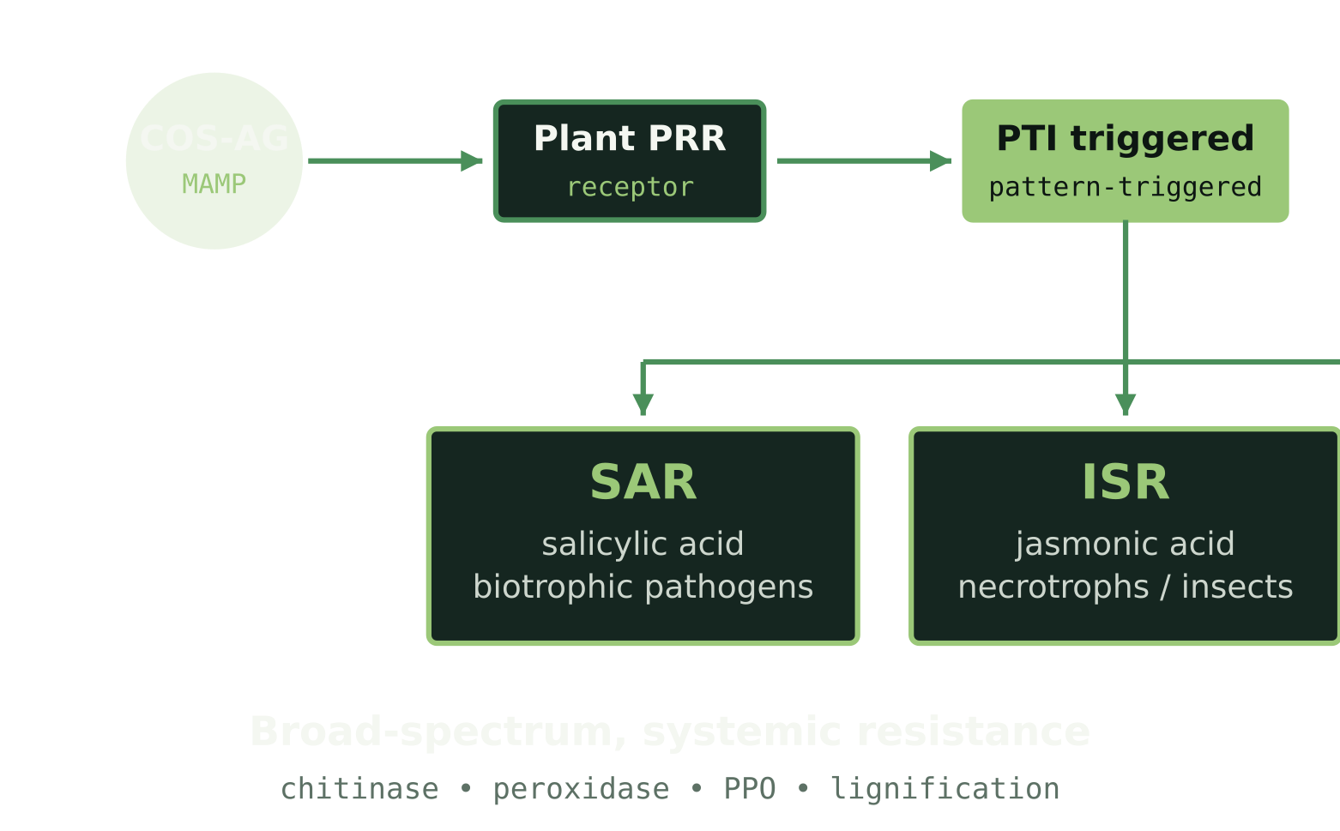




Chitosan Global • COS-AG Technical Brief
01 / 02
Chitosan AG: Activating Defense
in Broccoli & Peas
A water-soluble chitosan oligosaccharide hydrochloride that primes the plant's own immune system — turning crops into active participants in their own protection.
01 — The Molecule
02 — The Cascade
03 — In The Field
What Chitosan AG is
PTI → SAR + ISR
Benefits for broccoli & peas
A low-molecular-weight chitosan oligosaccharide hydrochloride — < 3,000 Da, 2–20 glucosamine units.
Stronger emergence & seedling vigor
Lower root & foliar disease pressure
Fully water-soluble — clean dissolution, no nozzle clogging
Better abiotic stress resilience
Rapidly absorbed via roots and leaves
Supports yield & quality potential
Tank-mix friendly with NPK, humic / fulvic, amino-acid biostimulants, Trichoderma, Bacillus
Outcomes depend on timing, crop condition, disease pressure and local validation. Sources: chitosanglobal.com/product/chitosan-oligosaccharide-hydrochloride-chitosan-ag; chitosanglobal.com/chitosan-for-plant-defense-and-crop-protection-systems; PMC10792498.

Slide 2






Program Integration • Application Rates
02 / 02
How to use it in existing programs
Four entry points across the broccoli & pea calendar — from seed to canopy — designed to slot into the spray plans, fertigation lines and biocontrol stacks you already run.
#
Method
Rate (% w/v)
Primary benefit
Formulation Note
A defense-eliciting co-input — not a fungicide replacement
01
Seed treatment
0.1 – 0.2 %
Early vigor + seed and seedling defense from day zero
02
Position Chitosan AG alongside conventional chemistry to help reduce fungicide and pesticide load and concentration over time.
Root drench
0.2 %
Root-zone immunity + transplant establishment
"May partially replace selected applications where field trials, labels and local regulations support it."
03
Drip irrigation
0.01 – 0.025 %
Low-dose continuous rhizosphere support
Before broad deployment
▸
Confirm tank-mix & formulation stability
04
Foliar spray
0.4 – 1.0 %
Leaf-level defense priming during disease pressure
▸
Verify water quality and target pH
▸
Validate crop safety on broccoli & peas
▸
Check local regulatory & label fit
Rates per grower program for broccoli & peas. Source dosing references: chitosanglobal.com/chitosan-in-agriculture-benefits-functions-and-dosages; chitosanglobal.com/chitosan-for-plant-defense-and-crop-protection-systems. Image (decorative): commons.wikimedia.org/wiki/File:Pea_field_by_Wood_Lane_-_geograph.org.uk_-_4993736.jpg.

