Slide 1












Chitosan Oligosaccharide in Swine and Poultry Feed
21 Peer-Reviewed Feeding Trials
21
2016-2025
10
11
Studies Included
Publication Period
Swine Studies
Poultry Studies
Inclusion & Exclusion Criteria
Key Findings Overview
Inclusion: 2016-present, peer-reviewed primary animal feeding trials, swine or poultry, dietary COS (true COS) or LC/LMWC flagged as chemistry caveat, outcomes in performance, gut health, immunity, oxidative status
Gut Health
Oxidative Status
Consistent improvements in intestinal barrier function and morphology
Enhanced antioxidant capacity across multiple species
Exclusion: Pre-2016, reviews/meta-analyses, theses/preprints, vaccine-only/non-feed routes, in vitro-only, non-swine/poultry
Chemistry Note: True COS ≠ LC/LMWC. Results stratified; LC/LMWC interpreted cautiously
Immune Function
Production
Modulated inflammatory markers and immune responses
Context-dependent growth performance improvements
Study Flow
Evidence Strength
21
10
11
● Moderate: Maternal sow programs, broiler stress mitigation
● Low: Nursery LC/LMWC, associative microbiota links
Studies Included
Swine Studies
Poultry Studies
Source: Spreadsheet of COS animal-feeding studies (2016-present)
Evidence-Based Review

Slide 2








Scope and Methods
Inclusion/Exclusion Criteria and PRISMA-Style Study Flow
Inclusion & Exclusion Criteria
PRISMA-Style Study Flow
Inclusion Criteria
Exclusion Criteria
2016-present peer-reviewed primary animal feeding trials
Pre-2016 studies
21 Studies Included in Qualitative Synthesis
Reviews/meta-analyses, theses/preprints
21
10
11
Swine or poultry species
Total Studies
Swine Studies
Poultry Studies
Dietary COS (true COS) or LC/LMWC flagged
Non-feed administration routes
Non-swine/poultry species
7
4
Outcomes: performance, gut health, immunity, oxidative status
True COS
LC/LMWC
Chemistry Note: True COS ≠ LC/LMWC. Results stratified; LC/LMWC interpreted cautiously.
10
11
17
4
Swine
Studies
Poultry
Studies
True COS
Studies
LC/LMWC
Studies
Evidence strength: Moderate for maternal sow programs; Low for nursery LC/LMWC
Source: Spreadsheet of COS animal-feeding studies (2016-present)
Evidence-Based Review

Slide 3

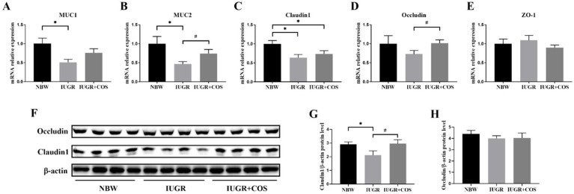

Swine Evidence Highlights
10 peer-reviewed studies (2016–2025): Maternal, weaned pig, and challenge-specific outcomes
Representative Study: Maternal COS & Piglet Intestinal Barrier
Study Categories & Outcomes
Maternal/Gilt Studies
Weaned Pig (True COS)
True COS 0.12–0.24 g/day improved milk yield, piglet weaning weight, immune markers
100 mg/kg for 21 d: ↑ ADG, digestibility, villus height, sIgA; ↓ MDA
Anim Nutr 2020
RSC Adv 2017
Weaned Pig (LC/LMWC)
Sow Reproductive
50–100 mg/kg: improved barrier/inflammation; attenuated ETEC-induced growth loss
COS 100 mg/kg: ↓ stillbirths, improved placental oxidative markers
Challenge-specific
Front Vet Sci 2024
Maternal COS supplementation improves placental and intestinal barrier function in sows and piglets
Key Findings
Maternal sow studies (COS ~100 mg/kg): Improved placental markers (GLUT1/3, VEGFA), reduced stillbirths/mummies, enhanced piglet intestinal barrier markers. Front Vet Sci 2024
Evidence strength: Moderate for maternal programs; Low for nursery LC/LMWC
Dosing Context
Sows: ~100 mg/kg from late gestation through lactation
Weaned pigs: 50–100 mg/kg; benefits strongest for gut integrity
LC/LMWC: 50–100 mg/kg; challenge-specific effects
Source: Spreadsheet of COS animal-feeding studies (2016-present)
Evidence-Based Review

Slide 4


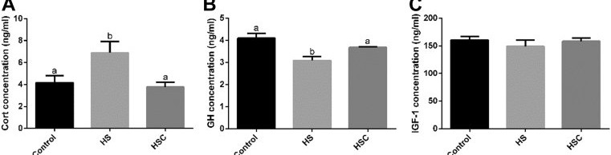
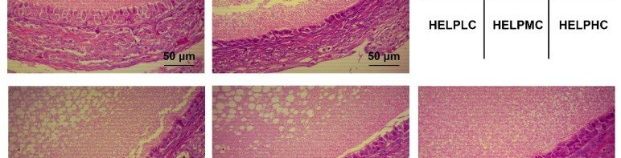


Poultry Evidence Highlights
Evidence-Based Review
11 peer-reviewed studies (2016–2025): Broiler challenge models and laying hen outcomes
Study Categories & Key Findings
Representative Study Images
Broiler Challenge/Stress Models
Coccidia Challenge
Dexamethasone Stress
~1 g/kg improved BWG, villus metrics, ileal digestibility; mitigated inflammation
1 g/kg mitigated growth/morphology declines; normalized cytokine/barrier genes
Br Poult Sci 2019
Poult Sci 2020
Heat Stress
Early Life (d1-14)
Heat-stress broiler endocrine response to COS supplementation
200-400 mg/kg improved growth maintenance, endocrine stress markers, meat quality
200-800 mg/kg improved intestinal development without growth changes
Poult Sci 2020-2021
Poult Sci 2024
Laying Hen Studies
Fatty Liver Syndrome
Mandarah Production
Layer fatty-liver syndrome: ovarian morphology improvements with COS
400-800 mg/kg improved laying rate, egg quality; ↓ ovarian oxidative stress
0.1-0.5 g/kg improved egg production, FCR, fertility, hatchability
Animals 2022
Ann Anim Sci 2024
Key Findings
• Stress mitigation: COS consistently improves oxidative status and gut development under challenge
• Meat quality: Enhanced under heat stress; 400 mg/kg optimal for antioxidant capacity
• Context-dependency: Benefits strongest in stress/challenge models
Dosing Context
Broilers:
200-1000 mg/kg depending on stress/challenge model; 400 mg/kg frequently optimal for meat-quality/antioxidant endpoints
Layers:
0.1-0.5 g/kg for productivity/egg quality; 400-800 mg/kg in FLS models
Evidence strength: Moderate for broiler stress mitigation; Moderate for layer productivity
Source: Spreadsheet of COS animal-feeding studies (2016-present)
Evidence-Based Review

Slide 5










Evidence Strength, Risk of Bias, and Practical Takeaways
Risk assessment, supported claims, and dosing guidance for swine and poultry applications
Evidence Strength & Risk Assessment
Practical Dosing Guidance
Maternal Sow Programs
Moderate
Broiler Stress Mitigation
Moderate
Sows
Weaned Pigs
~100 mg/kg from late gestation through lactation
Evidence: Front Vet Sci 2024/2025
50-100 mg/kg; strongest for gut integrity
Evidence: RSC Adv 2017
Nursery LC/LMWC
Low
Mechanistic Studies
Low
Claim Type
Status
Evidence
Broilers
Layers
200-1000 mg/kg depending on stress/challenge
Evidence: Poult Sci 2020-2021
0.1-0.5 g/kg for productivity/egg quality
Evidence: Ann Anim Sci 2024
Gut barrier & morphology
Supported
Consistent across species
Antioxidant status
Supported
Multiple studies confirm
Supported: Context-specific benefits in maternal sow programs and broiler stress mitigation
Universal growth promotion
Not supported
Context-dependent
Caution: Effects are dose-dependent and species-specific; not universal
Antibiotic replacement
Not supported
Insufficient evidence
Key: True COS ≠ LC/LMWC; chemistry matters for interpretation
Next Steps for Research
• Multi-site RCTs with standardized COS specifications
• Longer production-phase outcomes (≥42 days)
• Head-to-head comparisons with alternatives
• Mechanistic studies with causal pathways

