Slide 1



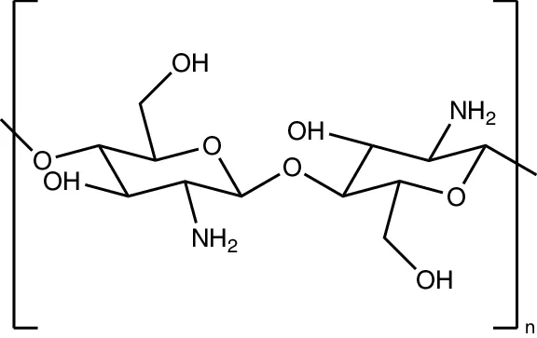







SCIENTIFIC LITERATURE SUPPORTED
CONFIDENTAL
The price for Chitosan – FG (Chitosan Oligosaccharide-Lactate) is $130/kg
The Future of Natural
Food Preservation
Food Grade Chitosan Oligosaccharide Lactate +60 mV Surface Charge
BSF & Fungal Sources
(Poly D-glucosamine)
Strong electrostatic pathogen elimination
Sustainable Black Soldier Fly & Mushrooms
Dosage
Target
Synthetic Replacement
Food Grade & Safe
0.3%
Food Pathogens
Replaces Benzoates & Sorbates
Biocompatible & Biodegradable
© 2026 Shield Nutraceuticals All Rights Reserved
Microplastic Adsorption
Fat Binding
Extended Shelf Life

Slide 2


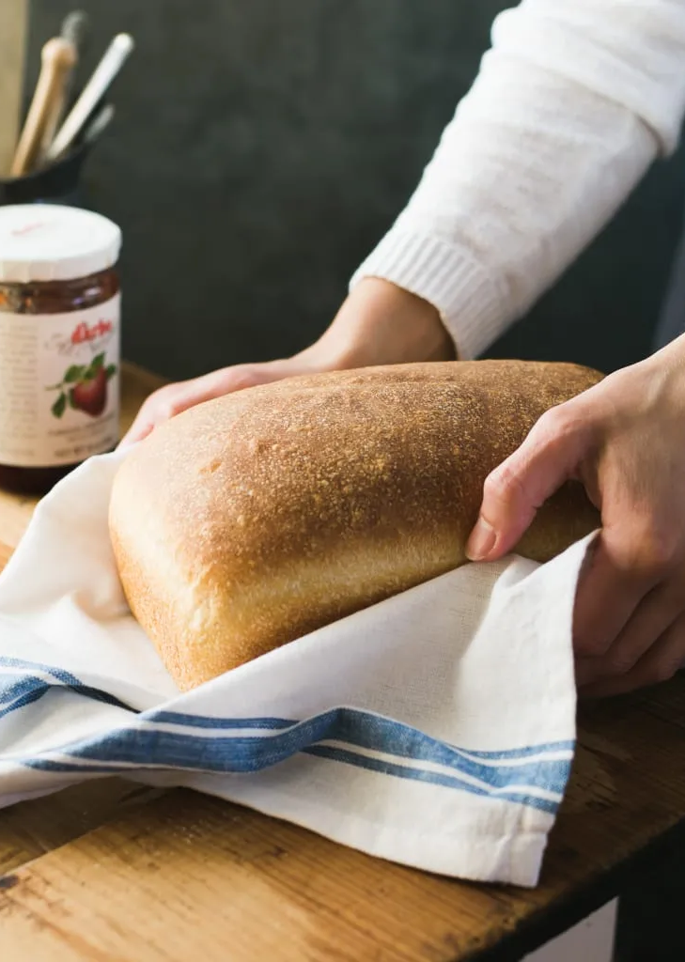











Market Context
Chitosan
Nature’s Preservative
As the food industry shifts away from synthetic additives, the search for effective, natural preservation methods has intensified. Chitosan offers a unique biological solution.
Global Challenge
1.3B
What is Chitosan?
Tons of food wasted annually, largely due to spoilage.
A cationic biopolymer derived from chitin (found in insects, fungi, and crustaceans). It is the second most abundant natural polysaccharide after cellulose.
Clean Label Trend
Preservation Pain Points
Consumers willing to pay more for natural preservatives.
Spoilage: Molds and bacteria cause massive food waste.
Consumer Trust: Growing skepticism of synthetic additives.
Clean Label: Urgent demand for recognizable ingredients.
The Natural Solution
A biocompatible, biodegradable antimicrobial that extends shelf life without compromising safety or labeling requirements.
02

Slide 3







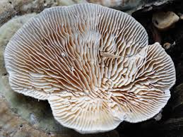






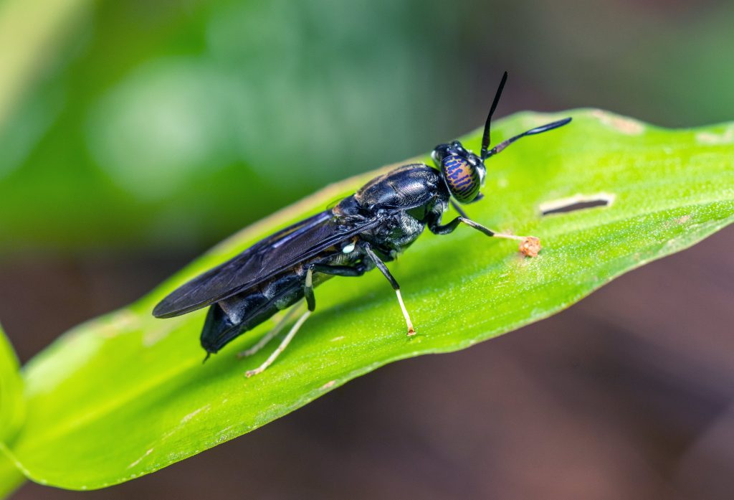




Product Profile
What Makes Chitosan - FG Unique?
Our Chitosan - Food Grade is engineered with a breakthrough surface charge of +60mV and optimized for ultra-low dosage application, Chitosan FG redefines food preservation standards.
+60 mV Surface Charge
Dual Bio-Sourcing
Industry-leading food-grade cationic zeta potential creates a powerful electrostatic shield. This high positive charge is critical for disrupting negatively charged pathogen membranes upon contact.
Sustainably extracted from two renewable streams: Lenzites Betulina or Agaricus Bisporus mushrooms, and Black Soldier Fly (BSF) larvae, ensuring supply chain resilience.
Source A: Lenzites Mushrooms
Food-Grade & Safe
Ultra-Low 0.3% Dosage
Fully biocompatible, biodegradable, and non-toxic. Compliant with food safety standards (GRAS) as a clean-label alternative to synthetic preservatives like benzoates.
Achieves potent preservation efficacy at just 0.3% concentration by weight. Highly cost-effective for bread, tortillas, and supplements without affecting texture.
Source B: Black Soldier Fly
03

Slide 4





















Mechanism of Action
Electrostatic Antimicrobial Power
Mode of Action
01
03
Electrostatic Binding
Metal Chelation
Positively charged amino groups (NH3+) of Chitonova-60 (+60 mV) are strongly attracted to the negatively charged cell membranes of pathogens.
Binds essential metal ions (Ca²⁺, Mg²⁺) and intracellular components, depriving microbes of nutrients critical for stability and replication.
+60 mV
-
-
Pathogen
02
04
Membrane Disruption
-
Barrier Formation
Interaction alters membrane permeability, causing leakage of intracellular constituents (electrolytes, proteins) leading to rapid cell death.
Forms a breathable polymeric film on the product surface that inhibits oxygen transfer and moisture loss, suffocating aerobic spoilage organisms.
Chitosan (+ Charge)
Pathogen (- Charge)
04

Slide 5















Versatility Profile
Dual Functionality
A single ingredient delivering powerful preservation for foods and detoxification benefits for health supplements.
Antimicrobial Action
Adsorption Matrix
Food Preservation
Health & Wellness
Powered by the +60 mV surface charge, Chitosan - FG acts as a broad-spectrum shield, preventing spoilage and extending shelf life naturally.
Functions as a potent binding agent in dietary supplements, utilizing electrostatic forces and hydrogen bonding to trap unwanted compounds.
Bacteria
Microplastics
Gram (+) & Gram (-) inhibition
Traps microscopic synthetic particles
Molds & Yeasts
Dietary Fats
Disrupts fungal cell walls
Binds lipids preventing absorption
Bio-Film Barrier
Bile Acids
Reduces oxidation & moisture loss
Supports cholesterol management
Combined Benefit
One biopolymer. Two high-value applications.
05

Slide 6











Scientific Validation
Evidence &Efficacy
Peer-Reviewed Literature
Structure-Activity
Mode of Action
2025
Breakthrough Study
Antimicrobial Potency
Primary Mechanisms
Microplastic Binding & Excretion
Activity is directly linked to cationic charge density and degree of deacetylation (DDA).
Validates membrane disruption and metal chelation as the primary modes of bacterial inhibition.
Kong et al., 2010; Int. J. Mol. Sci.
"Ingestion of chitosan promotes the excretion of polyethylene microplastics... The chitosan group showed increased fecal weight and excretion rate."
Rabea et al., 2003; Biomacromolecules
Application
Safety Profile
Shelf Life Extension
Biocompatibility (GRAS)
Proven efficacy in food systems and active packaging to significantly reduce spoilage rates.
Confirms favorable toxicity profile, biodegradability, and GRAS status for food applications.
Retention
Excretion
-40%
+115%
Coma, 2008; Meat Science
Kean & Thanou, 2010; Adv. Drug Deliv.
N
Nature Scientific Reports
Liu & Shimizu, 2025
All references available in full bibliography
06

Slide 7











Comparative Analysis
Health Benefits vs.
Synthetic Preservatives
Synthetic Concerns
Risk Factors
Sodium Benzoate • Potassium Sorbate • Calcium Propionate
Chitosan - FG offers a paradigm shift from chemical additives to functional wellness ingredients, addressing modern consumer demands for clean labels.
Artificial Perception
76% of consumers actively avoid artificial preservatives. "Chemical phobia" is a primary driver in modern purchasing decisions.
Chitosan - FG Advantages
Regulatory Pressure
Clean-Label & Natural
Increasing scrutiny on Acceptable Daily Intake (ADI) levels, particularly for benzoates due to potential benzene formation risks.
Recognized as a natural ingredient (GRAS), supporting "preservative-free" marketing claims crucial for premium positioning.
No Nutritional Value
Synthetics exist solely for shelf life extension. Unlike chitosan, they offer zero fiber content or health-promoting properties.
Functional Wellness
Offers potential gastrointestinal benefits through lipid binding, while being fully biocompatible and biodegradable.
"The shift to clean label is not a trend, it's the new standard for food safety and transparency."
Superior Sensory Profile
Avoids the bitter, metallic, or chemical aftertaste often associated with high levels of benzoates and sorbates.
07

Slide 8

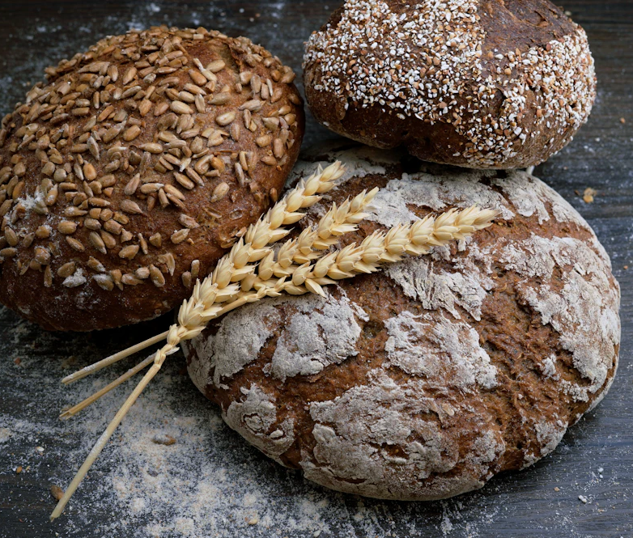







Applications & Formulation
Bread, Tortillas & Baked Goods
Recommended Dosage
0.3%
Standard addition by total product weight
w/w
Formulation Calculator
Base Calculation
Standard Loaf
Tortilla Pack
3 g (.3%) x $.135 (based on $135/kg)
2.1 g x $.135 = $.2835
1.5 g x $.135 = $.2025
Baked Goods & Tortillas
per 1 kg Dough
per 700g Loaf
per 500g Pack
Ideal for high-moisture bakery products prone to rapid spoilage. Provides a natural defense mechanism without altering texture.
Target: Common Molds (Aspergillus, Penicillium)
Dry Blend
Aqueous Dispersion
Target: Rope Spoilage (Bacillus subtilis)
Direct incorporation into flour mix before hydration. Ideal for breads and dough-based products to ensure uniform distribution.
Dissolved for spray or brush application on surfaces. Best for tortillas and flatbreads to prevent surface mold growth.
RTE & Snacks
Surface coatings for dried fruits, nuts, and snack bars.
08

Slide 9





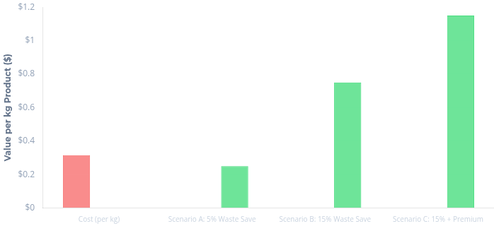





Financial Overview
Base Price
Cost-Benefit Analysis
$135 / kg
Direct Ingredient Cost
Value Recovery & ROI Scenarios
Investment
Recovered Value
Cost per kg Product
$0.45
@ 0.3% Usage
Based on $135/kg Chitosan – FG ingredient cost
Bread Loaf
$0.28
Standard 700g Unit
per loaf
Tortilla Pack
$0.20
Standard 500g Pack
per pack
Waste Reduction
Premium Pricing
Simplification
5-15% reduction in stales/returns effectively pays for the ingredient cost through retained revenue.
"Clean Label" positioning allows for $0.20-$0.50 price premiums, generating positive ROI immediately.
Replaces multiple additives (preservatives + conditioners), consolidating supply chain costs.
Calculations assume optimized formulation addition rate of 0.3% by total dough weight.
09

Slide 10




Competitive Landscape
Chitosan - FG vs. Synthetic Preservatives
Advantage
Neutral
Limitation
Preservative Agent
Mechanism & Spectrum
Dosage
Cost Impact
Label & Sensory
Chitosan - FG
Cationic Disruption (+60mV)
0.3%
~$0.28 /700g product
Clean Label
Breakthrough
Bacteria
Yeast
Mold
Optimized Rate
Natural / GRAS / No off-taste
Value Investment
Calcium Propionate
Metabolic Interference
0.2 - 0.3%
~$0.008
Synthetic Additive
Standard for Bread
Molds
Rope
Bitter at high levels
Potassium Sorbate
Enzyme Inhibition (pH <6)
0.05 - 0.2%
~$0.005
Synthetic Additive
Standard for Cakes/Tortillas
Yeast
Molds
pH Dependent efficacy
Sodium Benzoate
Intracellular Acidification
0.05 - 0.1%
~$0.002
Synthetic Additive
Standard for Acidic Foods
Yeast
Bacteria
Metallic taste / Benzene risk
* Cost per kg of finished food product based on typical usage rates ($135/kg for Chitonova-60 at 0.3%) and current bulk ingredient pricing.
10

Slide 11













Eco-Profile
Sustainability & Safety
Circular Economy Design
Renewable Sources
Biodegradable
Biocompatible
Circular Upcycling
Derived from rapidly renewable BSF insect farming and Lenzites fungal biomass.
Naturally decomposes into non-toxic compounds. Non-persistent in aquatic or terrestrial environments.
Generally Recognized As Safe (GRAS) status. Safe for food contact and dietary supplements.
Valorizes side streams from commercial protein production, transforming waste into high-value preservation.
Insect
Fungi
Zero Microplastic Residue
Non-Toxic Profile
Waste-to-Value
Sustainable Replacement Strategy
100%
0%
Replacing persistent synthetic chemicals with bio-based solutions reduces overall environmental load.
Bio-Based
Petrochemicals
11

Slide 12









Strategic Advantage
Why Chitosan is the Ideal Natural Preservative
"The Gold Standard for Natural Preservation"
Broad-Spectrum Efficacy
Functional Barrier Properties
Potent activity against a wide range of spoilage microorganisms including Gram-positive/negative bacteria, yeasts, and molds, unlike narrow-spectrum synthetics.
Forms microscopic, breathable films on food surfaces that physically retard lipid oxidation and reduce moisture migration, extending freshness beyond just microbial control.
Synergistic Compatibility
Consumer Trust & Clean Label
Works effectively alongside other preservation hurdles such as low pH, salt reduction, and Modified Atmosphere Packaging (MAP), enhancing total system stability.
Replaces "chemical-sounding" benzoates and sorbates with a recognizable natural ingredient, directly addressing consumer demand for transparency and safety.
No Microbial Resistance
Safety & Regulatory Status
Relies on physical membrane disruption (electrostatic interaction) rather than metabolic interference, preventing pathogens from developing resistance over time.
Natural origin with GRAS (Generally Recognized As Safe) status. Approved for diverse food contact and dietary supplement applications worldwide.
Chitosan is the second most abundant biopolymer in nature after cellulose.
12

Slide 13










Innovation Spotlight
Why Chitosan - FG is a Breakthrough
First of its Kind
Engineered Surface Charge
Ultra-Low Dosage
First-of-its-kind +60 mV potential. Precisely engineered for optimal electrostatic interaction with pathogen membranes.
Requires only 0.3% by weight for full efficacy. Drastically reduces cost-in-use compared to standard 0.7-1.0% solutions.
Revolutionary
CHITOSAN - FG
+60mV
Food Grade Chitosan
Hybrid Functionality
Synthetic Displacement
Designed for dual roles: A potent preservative in food systems AND an active adsorption agent in dietary supplements.
Replaces benzoates & sorbates. Enables "Clean Label" claims while maintaining rigorous shelf-life goals.
13

Slide 14



























Market Landscape
Market Opportunity & Applications
High-Growth Sector
Target Application Categories
Food Systems
Supplements
The Clean Label Surge
Consumer Demand Shift
7.2%
78%
CAGR (Natural Preservatives)
Consumers Check Labels
"Rising rejection of synthetic additives like benzoates is driving reformulation across bakery and RTE sectors."
Bakery
Tortillas
RTE Meals
Molds & Rope spoilage control in breads.
Preventing sticking and mold in flatbreads.
Pathogen protection for ready-to-eat meals.
Strategic Entry Points
Premium SKUs
Launch in "All-Natural" or "Artisan" lines
Waste Reduction
Sustainability & extended freshness ROI
Clean Label
Sauces
Fresh Produce
Supplements
Replace E-numbers with "Mushroom Extract"
Stability in dressings without synthetics.
Edible coatings for fresh-cut fruit/veg.
Lipid binding and microplastic adsorption.
High Efficacy @ 0.3%
Cost-Effective
Clean Label Solution
14

Slide 15













Executive Summary
Path Forward with Chitosan - FG
Conclusion & Next Steps
Key Takeaways
Next Steps
Potent & Clean Label
Scientifically Validated
Phase 1
Dual-function chitosan combining robust antimicrobial action with microplastic adsorption. A true clean-label alternative to synthetics.
Mechanism of action (+60mV charge disruption) is strongly supported by peer-reviewed literature and efficacy studies.
Request Samples
Receive 100g Chitonova-60 sample kit for initial formulation testing.
Phase 2
Defined Application
Superior ROI Model
Pilot Trials
Clear pathway for implementation in bakery and RTE foods at 0.3% w/w dosage for optimal preservation.
At 0.3%, cost per unit drops significantly ($0.22/loaf), maximizing margins while offering premium "Natural" positioning.
Conduct 0.3% w/w trials in bread/tortillas with technical support team.
Phase 3
Shelf-Life Study
Design comparative shelf-life study vs. current preservative system.
Full Bibliography Available: Comprehensive list of scientific references supporting all claims in this presentation is available upon request.
© 2026 Nutraceuticals All Rights Reserved
Ready to Innovate?
Contact our technical team to schedule your trial.
Chitosan Global
+1 423-202-6145
15
steve@chitosanglobal.com
www.chitosanglobal.com

